Slide 1
TPAC1.1 Progress JC: Dec 8th

Slide 2
Laser
No further investigation of odd scans on V1.1
De-ionizing filter needs replacing
On order…
Bulb needs replacing
Manual says >30M shots intensity starts to vary
We’ve done 88M shots!
On order…

Slide 3
Chip Alignment
Hand-placed two 12u+DPW parts on a PCB so the test pixels were aligned with centre of PCB hole
Significant offset from “standard” position
Confirms most test pixels will be near the edge of the PCB hole
Will scan one of these hand-placed parts when laser is available
Propose to not place all chips in the new (offset) location as they would then not be well aligned when placed in a stack configuration

Slide 4
Yield
Probed & bonded some more devices
 |  | Probed ok | of # tested |  |  | Bonded ok | of # bonded
5u no DPW | wafers 1,2 | 12 | 25 | 48% |  | 1 | 1 | 100%
5u with DPW | wafers 5,6,7 | 12 | 25 | 48% |  | 4 | 7 | 57%
12u no DPW | wafers 9,10,11 | 6 | 25 | 24% |  | 1 | 1 | 100%
12u with DPW | wafers 13,14,15 | 16 | 60 | 27% |  | 16 | 17 | 94%

Slide 5
PCB Summary
PCB | Sensor | Status | Preferred
37 | 5u +DPW | At RAL; Ok
40 | 5u +DPW | At RAL; Ok
32 | 12u +DPW | At RAL Two dead columns; Used for analog test pixels (laser, 55Fe)
35 | 5u +DPW | At RAL Severe data corruption – to be investigated
36 | 5u +DPW | At IC; Ok
31 | 12u +DPW | At RAL; Ok | ←
32 | 12u +DPW | At RAL; Ok | ←
38 | 12u – DPW | At RAL; Ok
34 | 5u –DPW | At RAL; Ok
26 | 12u +DPW | At IC; Ok | ←
27 | 12u +DPW | At RAL; Ok | ←
24 | 12u +DPW | To be tested | ←
25 | 12u +DPW | To be tested | ←
28 | 12u +DPW (aligned) | To be tested
30 | 12u +DPW (aligned) | To be tested

Slide 6
Configuration Registers
Were reporting many errors and not holding the correct data
Problem due to different power domains and high loading of “slow” clock drivers
Fixed by driving one of the power domains at 1.6v (previously 1.8v)
Implemented using the power module developed for TPAC1.0 with updated resistor values and driving VDD1V8sram through J7
1.8v
1.8v
clk
SR
Periphery
Pixel

Slide 7
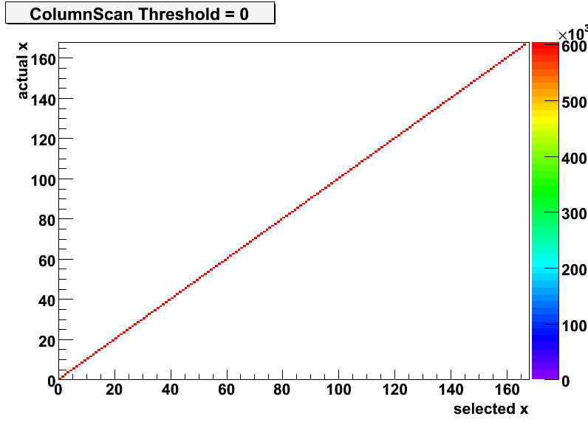
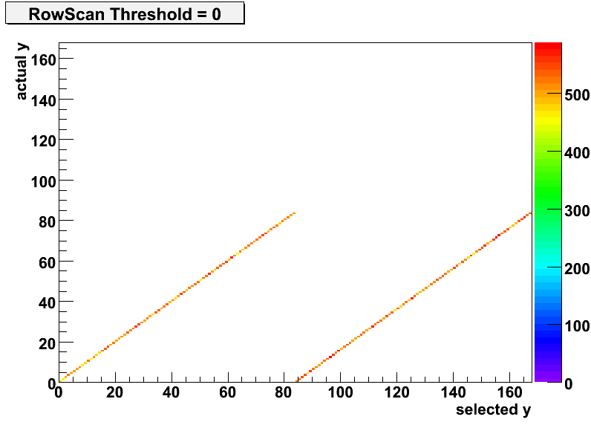
Data Integrity
Row & Column masked scans look ok
Row address bug repeats row codes 0→83

Slide 8
Comparator Simulation (DC)
Sweeps: Threshold
common-mode
(1.75)
(0.25)
Vcm | ~TU
0.25 | 625
0.5 | 1250
0.75 | 1875
1 | 2500
1.25 | 3125
1.5 | 3750
1.75 | 4375
(0.5)
(1.5)
(0.75)
(1.25)
(1.0)
Threshold (mV) necessary to fire the comparator
Vin = 1v + Vsig
Vth = Vcm ± (Vth/2)
Signal Magnitude (mV)

Slide 9
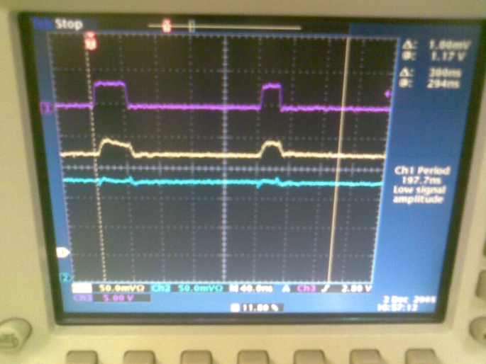
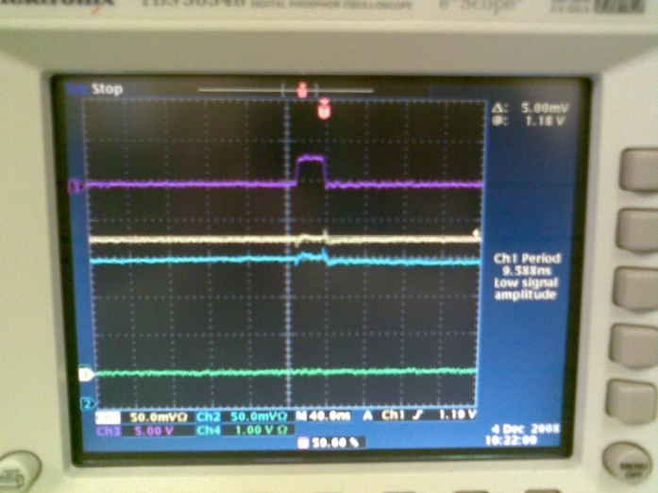
Comparator Operation
Test pixels give access to comparator inputs and outputs…
Worrying effects (not yet fully understood)
Set a very low threshold
Comparator fires (on noise)
Injection into shaper circuit
Effect is more pronounced in new pixel
Can oscillate at certain low thresholds
Probably explains the non-gaussian profiles
Needs further investigation
Layout scrutiny
Response to signal
New pixel
Old pixel

Slide 10
Next steps
Need to see how TPAC1.1 performs in bulk with high-rate source
Marcel’s 55Fe results need to be confirmed
Would like to observe operation of comparator with repeatable signal source (laser)

