Slide 1
TPAC1.1 Testing JC/Feb 6th

Slide 2
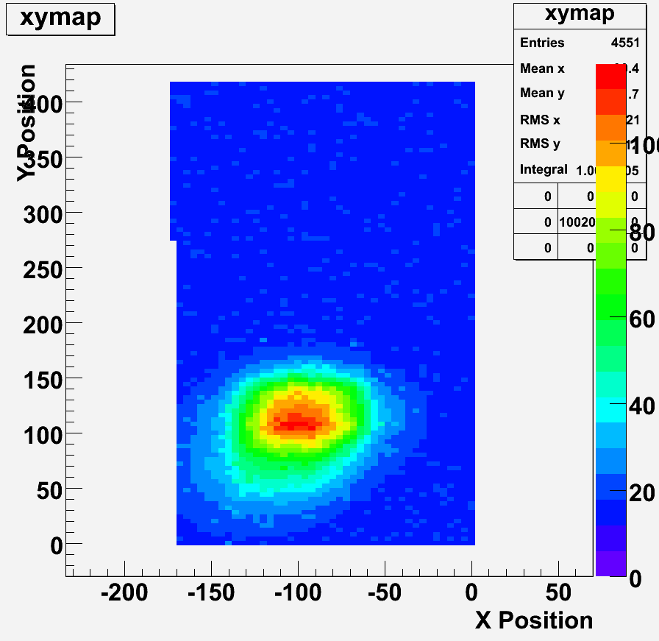
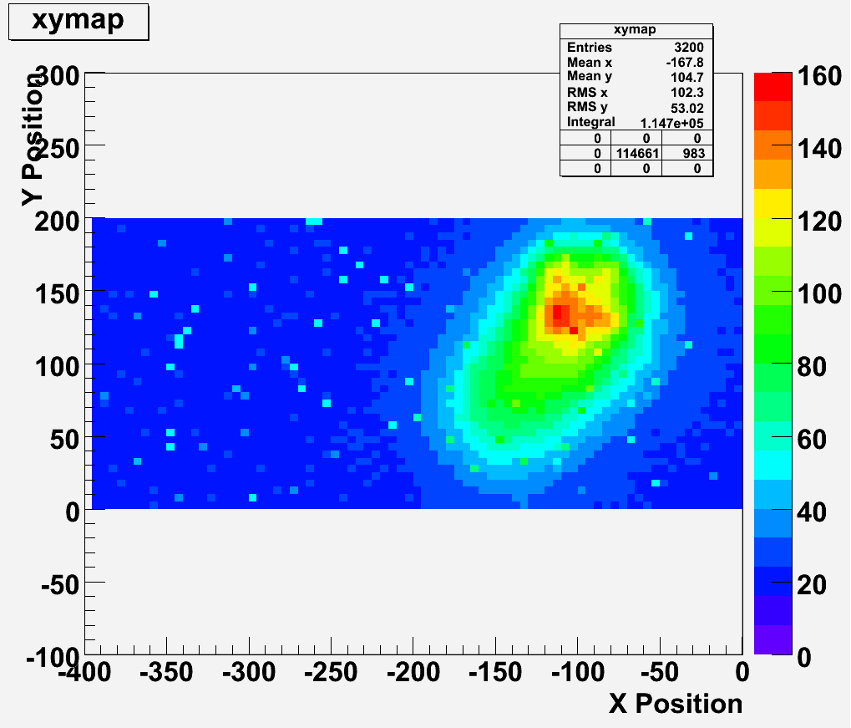
Laser Scan: Test Pixel
Test pixels were mounted specially in centre of pcb hole
2um spot
4um steps
50 measurements/pt
→ Before:
Effect hasn’t entirely disappeared!
Should repeat with aluminium plate removed and check alignment etc

Slide 3
Laser Scan: Repeated!
Removed aluminium back plate
Black plastic under sensor
Next:
Rotate sensor 90˚
Repeat

Slide 4
TU calibration
Method
Fire laser at ~centre of (v1.1) test pixel
Set fixed threshold for test pixel
Adjust laser intensity
Record mean signal magnitude
can adjust aperture or intensity to get larger signals
Record probability of hit from scope (>300 samples)
Plot s-curve of p(hit) against signal magnitude
Estimate p(hit)=0.5 for each threshold setting
Plot TU versus signal magnitude
Repeat for several sensors…

Slide 5
TU calibration plot: all data

Slide 6
TU calibration plot: refined method
0.5mV/TU
0.4mV/TU

