Slide 1
TPAC1.2 Results
Jamie Crooks
1st June 2009

Slide 2
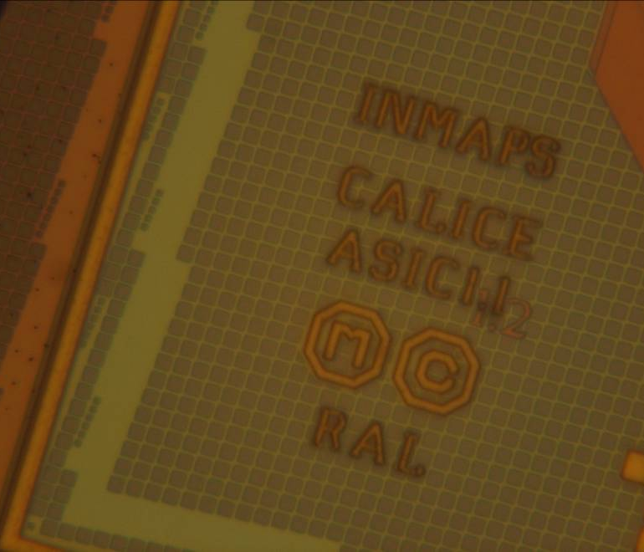
Status
TPAC1.2 received
WAFERS | EPI | SUBSTRATE | DPW | DICED QTY
3 | 12 | STD | YES | 75
3 | 12 | STD | NO | 75
3 | 12 | HI RES | YES | 75
3 | 18 | HI RES | YES | 75

Slide 3
Status
7 chips now bonded, 5 more in progress
0 power-ground shorts ☺
5 usable sensors today
PCB | WFR | VARIANT | ALIGNMENT | TEST | NOTES
50 | 3 | 12u +DPW | LASER | Configuration errors (all cols)
29 | 3 | 12u +DPW | LASER | Ok | Paul/CALICEDAQ1
43 | 3 | 12u +DPW | LASER | Ok | Marcel/55Fe
41 | 3 | 12u +DPW | LASER | Ok, with configuration errors (col 53 only)
21 | 9 | 12u HIRES + DPW | LASER | Ok, with configuration errors (col 148 only)
44 | 2 | 12u +DPW | CENTER | Ok
42 | 2 | 12u +DPW | CENTER | Spill fails
47 |  | 12u +DPW | CENTER
46 |  | 12u +DPW | CENTER
45 |  | 12u +DPW | CENTER
23 |  | 12u +DPW | CENTER
48 |  | 18u HIRES + DPW | LASER

Slide 4
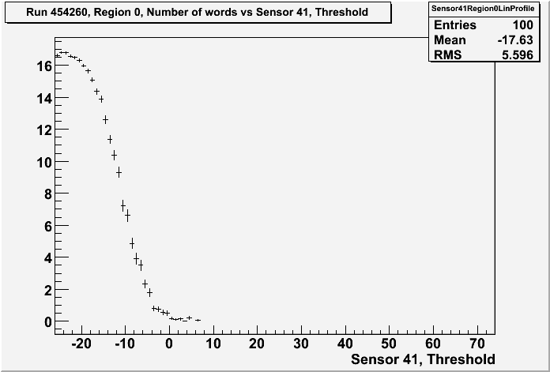
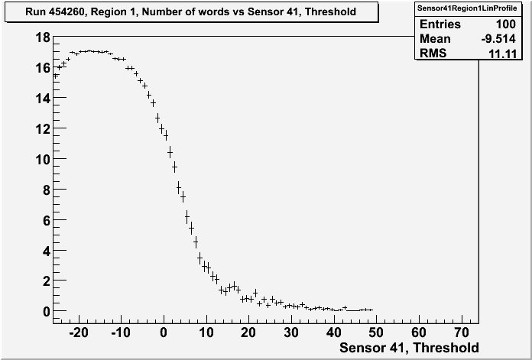
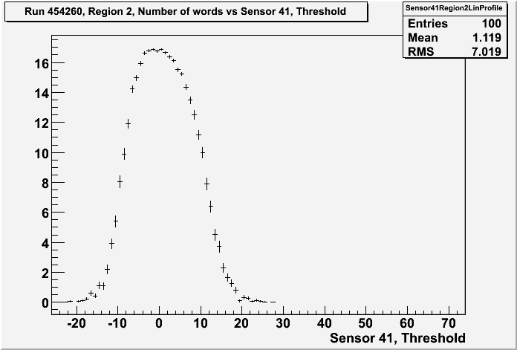
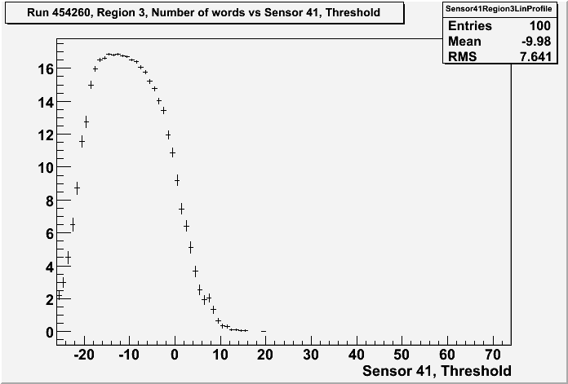
Per-Pixel threshold scans (noise)
Randomly selected single pixel in each region
Noise is Gaussian ☺
Pixel shielding added on metal 2 appears to help
Coupling/oscillation at low thresholds is not evident

Slide 5
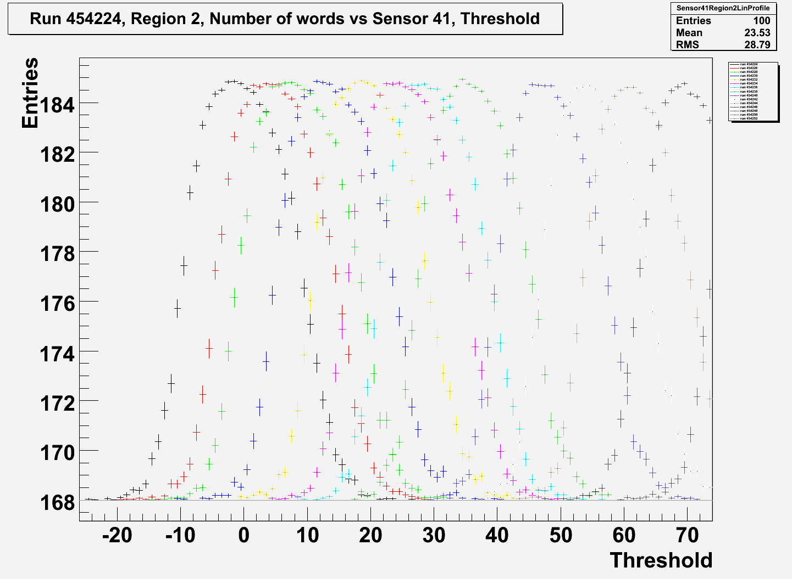
Single pixel trim scan
Trims 0,2,4,6,8,10,12,14,16,18,20,22,24…
The trim range still needs to be set up correctly
Was never done for TPAC1.1 which had the larger #bits
May involve a resistor value change
Once per-pixel spread is known I can set this
Sooner the better (for modifying PCBs)
Currently the range should be twice that on TPAC1.0 with 4x resolution

Slide 6
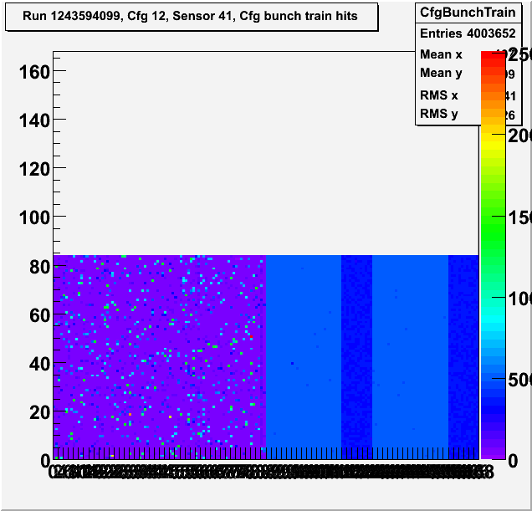
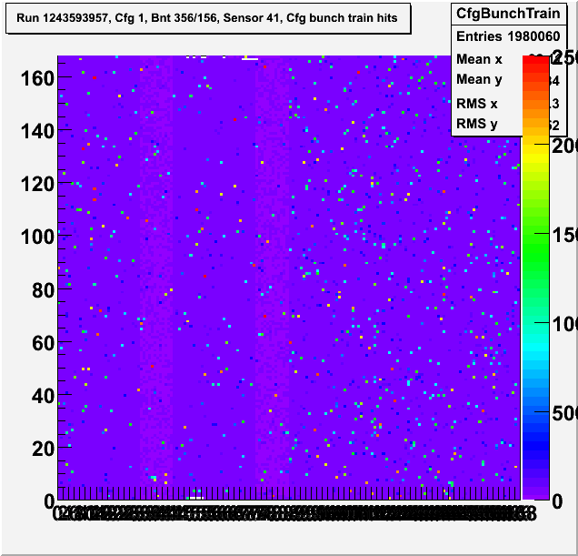
Pixel addresses (noise)
TPAC1.1
Addressing bug
TPAC1.2
Full addresses restored

